Slide 1
Nishiiyuu Life Skills Personal Development Program
Half Day Introductory Program

Slide 2

What is this Program About?

Slide 3
This program is focused to give anyone who follows it, the power to set purpose, create vision, and manifest their vision
“Living Life The Nishiiyuu Way”

Slide 4
Purpose of this Program
To create a new mindset, the Nishiiyuu Way, the Wisdom of which is to be transferred and transmitted by the Elders to the Youths and Adults.

Slide 5

To Help Develop Purpose and Find Their Vision For Life
Many go through life, morning to night, every day without a Vision and Purpose

Slide 6
What is the Nishiiyuu Way?
“The Nishiiyuu Way Personal Development Program empowers the individual by cutting through the debris of their past conditioning and limitations and giving the individual the key to setting purpose by finding their Nishiiyuu identity.
They will re-create themselves and build a positive future with purpose

Slide 7
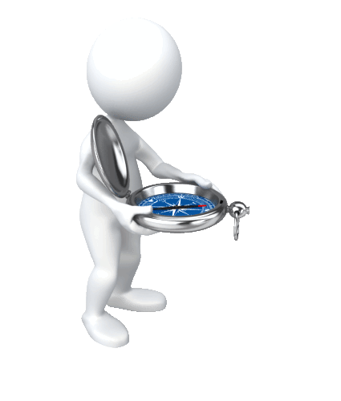
Without Goals and Vision Empowerment is Ineffective
If we don’t know where we are going, the best vehicles cannot take us there
A purpose-less life is excruciatingly painful; we cover it up by being busy with no purpose
"If a man does not know to what port he is steering, no wind is favourable to him“… Seneca
A Vision to Arrive...Port

Slide 8
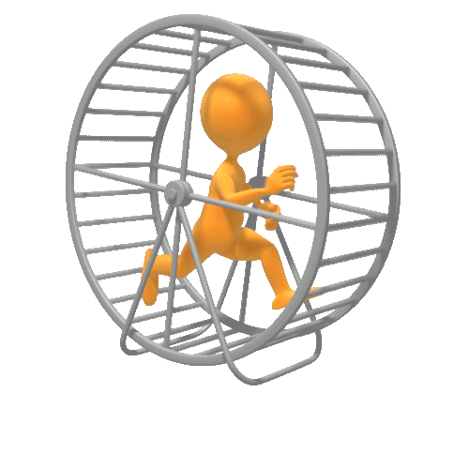
A Person Without A Purpose Goes In Circles; Ends Up In The Same Place
They work hard to go nowhere

Slide 9
The Nishiiyuu Way of Setting Purpose
The greatest gift the Creator has given us….
The Power To Choose
Not only that,
The Freedom To Choose

Slide 10
The Objectives of this Program
Motivate and empower the youth for healthy body, mind and spirit the Nishiiyuu Way
Learn the culture and traditions from the Elders and keep the traditions and culture alive for generations to come
Minimize self inflicted injuries and abuses

Slide 11
Objectives cont.
Reinventing and recreating the sense of values based on Nishiiyuu Self-identity
To break free from the past conditionings of abuse and failures, learn from it with the Nishiiyuu concept and build purpose with renewed strength
To build a life for family and community of health, balance and wealth

Slide 12
Objectives cont.
Self Identity
Understanding other cultures from Nishiiyuu perspective to broaden the horizon and deal with the rest of the world with dignity and respect

Slide 13

Transformation of the Individual
This is a course in transformation of the youth and the adult with our Ancestral Teachings as given to us by our Elders to train the Eeyou/Eenou Region, The Nishiiyuu Way.
Role models will be created to pass on the baton of the Nishiiyuu Way to their children and grand children

Slide 14
There is a saying…
“Tell me I will forget
Show me, I will remember
Involve me, I will understand”
All training will be based on involvement from a Nishiiyuu perspective

Slide 15
You will leave this Program…
Knowing the Nishiiyuu Culture is as great as all the other cultures
Knowing The Nishiiyuu Way will enable you to withstand adversities and grasp opportunities
With pride and respect for your own culture not because it belongs to you, but because it is the truth

Slide 16
You will leave this program…
Discovering your Nishiiyuu Self-Identity and proudly promote your identity to the world
Eager to learn and understand other cultures while staying firmly rooted in the foundation of the Nishiiyuu Culture
Focused with the power to set purpose, create vision, and manifest your vision

Slide 17
You will leave this program…
Being able to set vision not from the limitations of the past but the freedom of the Nishiiyuu Ways
With a new mind set, a Nishiiyuu Way mind as the Elders have advised
Able to maintain your mental balance and calmness in the midst of immense change you face every day of your life

Slide 18

Let’s start….

Slide 19
And It All Starts With… Self Identity.
What you think of Yourself?

Slide 20

Take a good hard look at yourself

Slide 21
Answer these 3 Questions…
Take 5 minutes now to write down your answers to each of the following three questions

Slide 22
What Do You Want
…To Be?
…To Do?
…To Have?

Slide 23
Liberty is the ability:
To Be what you want to Be
To Do what you want to Do
To Have what you want to Have

Slide 24
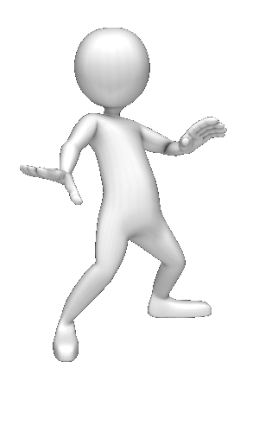
But first to be true to yourself, you have to know your Self Identity

Slide 25
Finding Your Self Identity
Who am I?
What am I doing here?
Where is here?

Slide 26
Ask yourself these questions…
Where am I going to?
What is my Purpose here?
Why do I do the things that I do and the way that I do it?

Slide 27
The answers are…your Self-Image which is your Power Source
Your Self-Image makes you what you are
The sum total of your beliefs & memory, understanding and knowledge

Slide 28
You are totally dependent on your Self-Image for everything you do
That is your unfailing dependency

Slide 29
Your Goals… Your Visions… Your Aspirations …and all your response system is directly limited by your Self-Image

Slide 30
We cannot see or think what we are not
We cannot desire what we cannot be
We are trapped in our Self-Image

Slide 31

How many people approach their life

Slide 32
All the thoughts that you think or capture from the Universe has to filter through your Self Image before it can enter your heart.

Slide 33
If your Self-Image doesn’t agree with the thought that you are entertaining then it will not be permitted to enter your heart
You CANNOT think that thought

Slide 34


Slide 35
If today I told you to think of being a Billionaire, you will laugh at me. Why?
“As a man thinketh in his heart, so is he.” James Allan
Because your current Self Image would not permit this thought to enter your heart.

Slide 36
But if I told a Billionaire that he should be thinking of making another Billion this year he would not laugh, rather he will be entertaining that thought.
Why?
Because he has the Self Image of a Billionaire. His Billionaire Self Image will allow the thought of making another Billion to enter his heart.

Slide 37

So how Is our Self Image Formed?

Slide 38
V
O
J

Slide 39
V … Voice
O … Of
J … Judgment

Slide 40
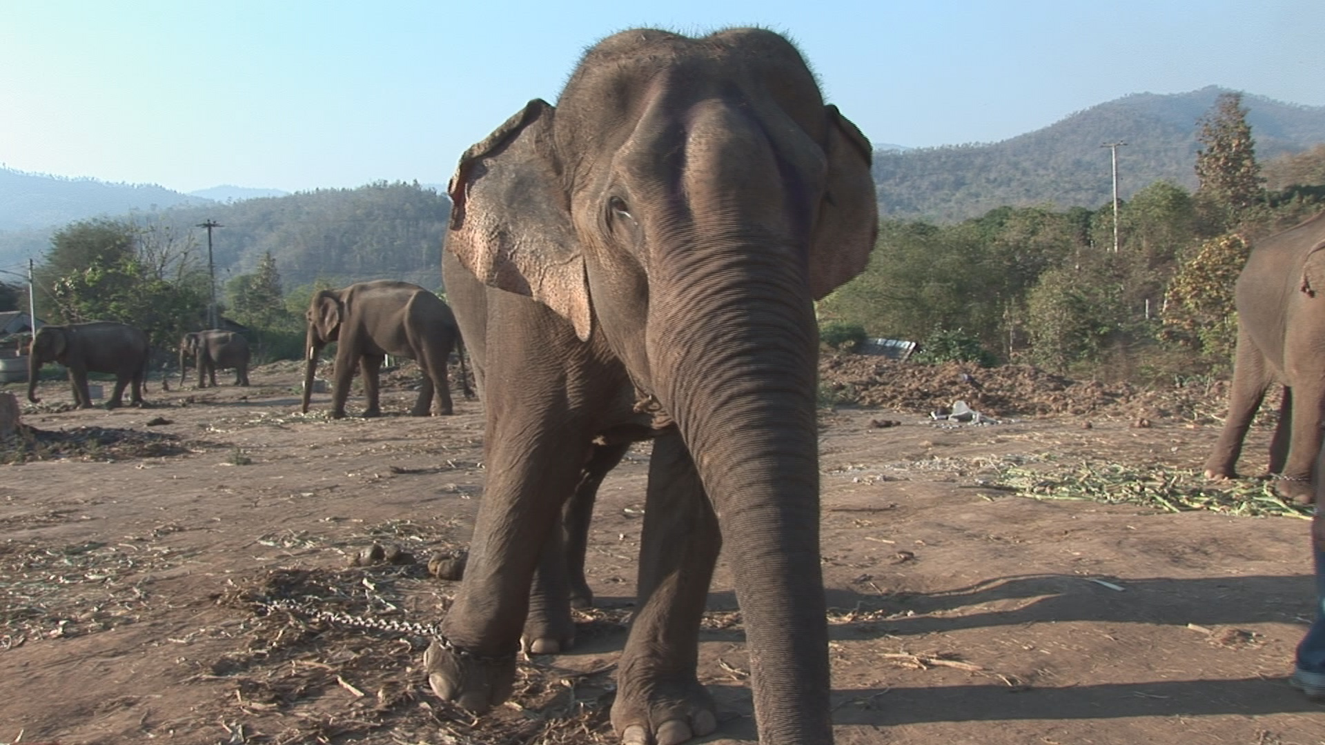

Slide 41
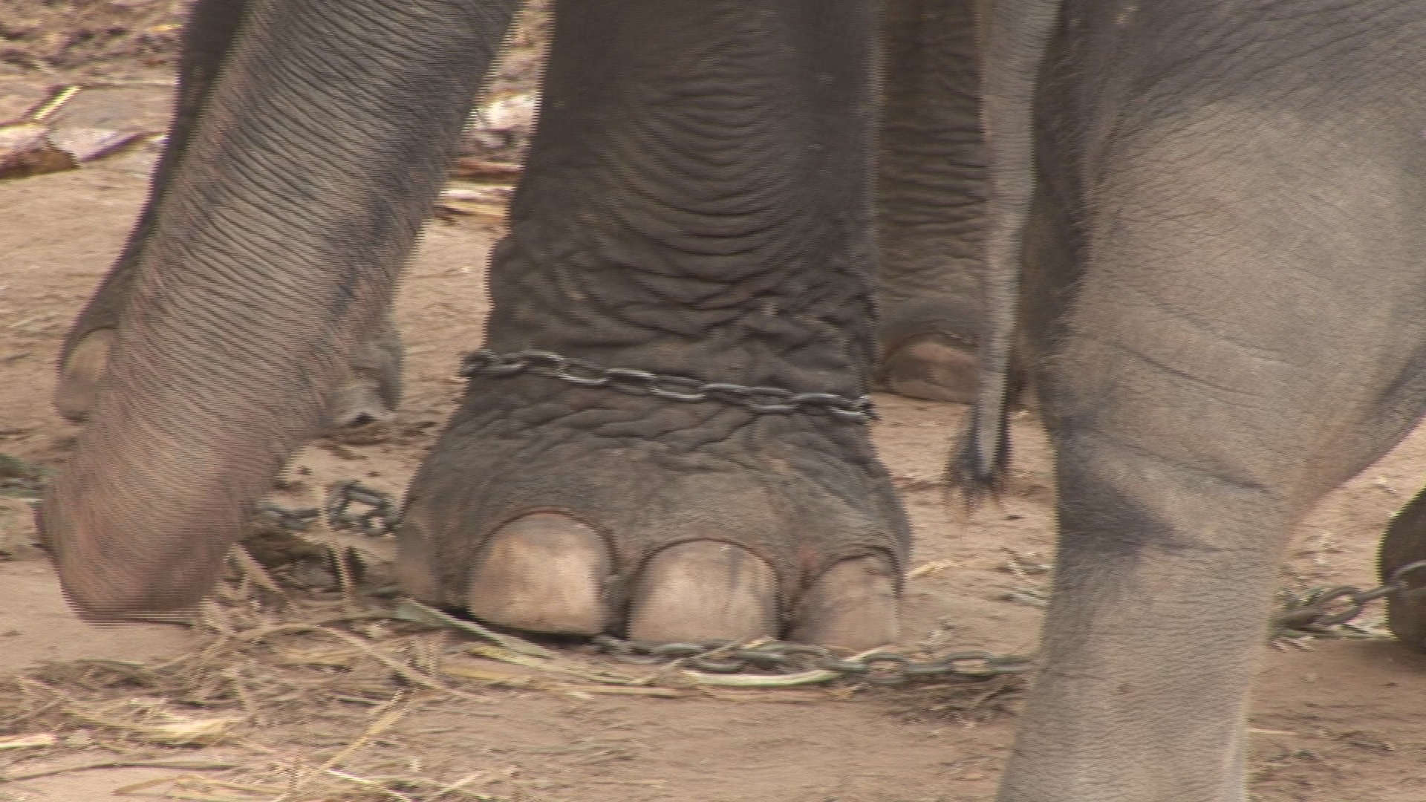

Slide 42
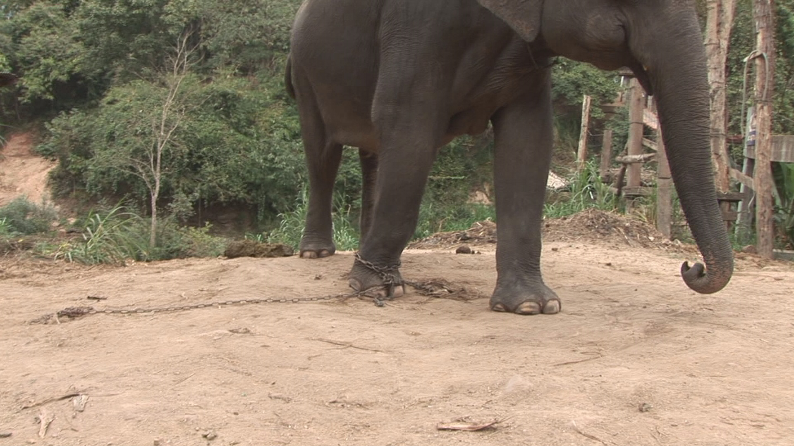

Slide 43
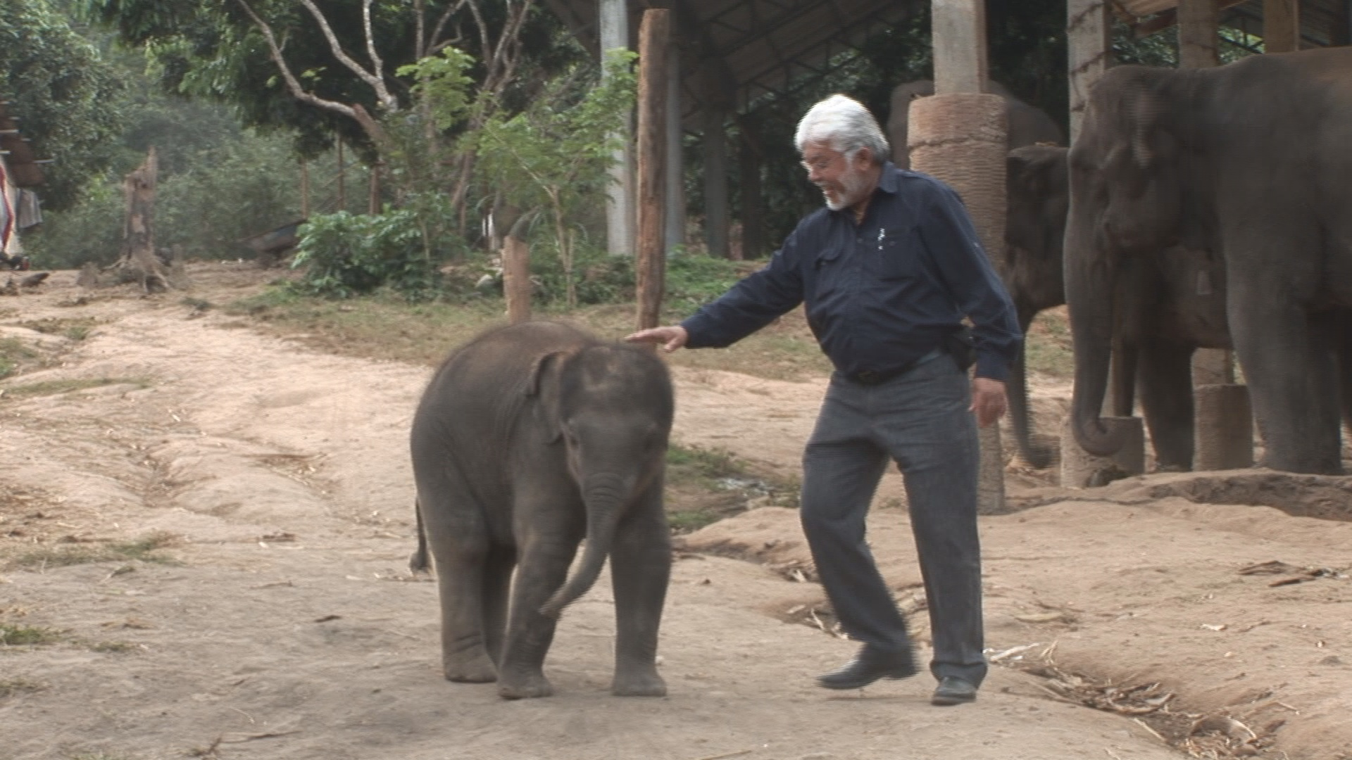

Slide 44
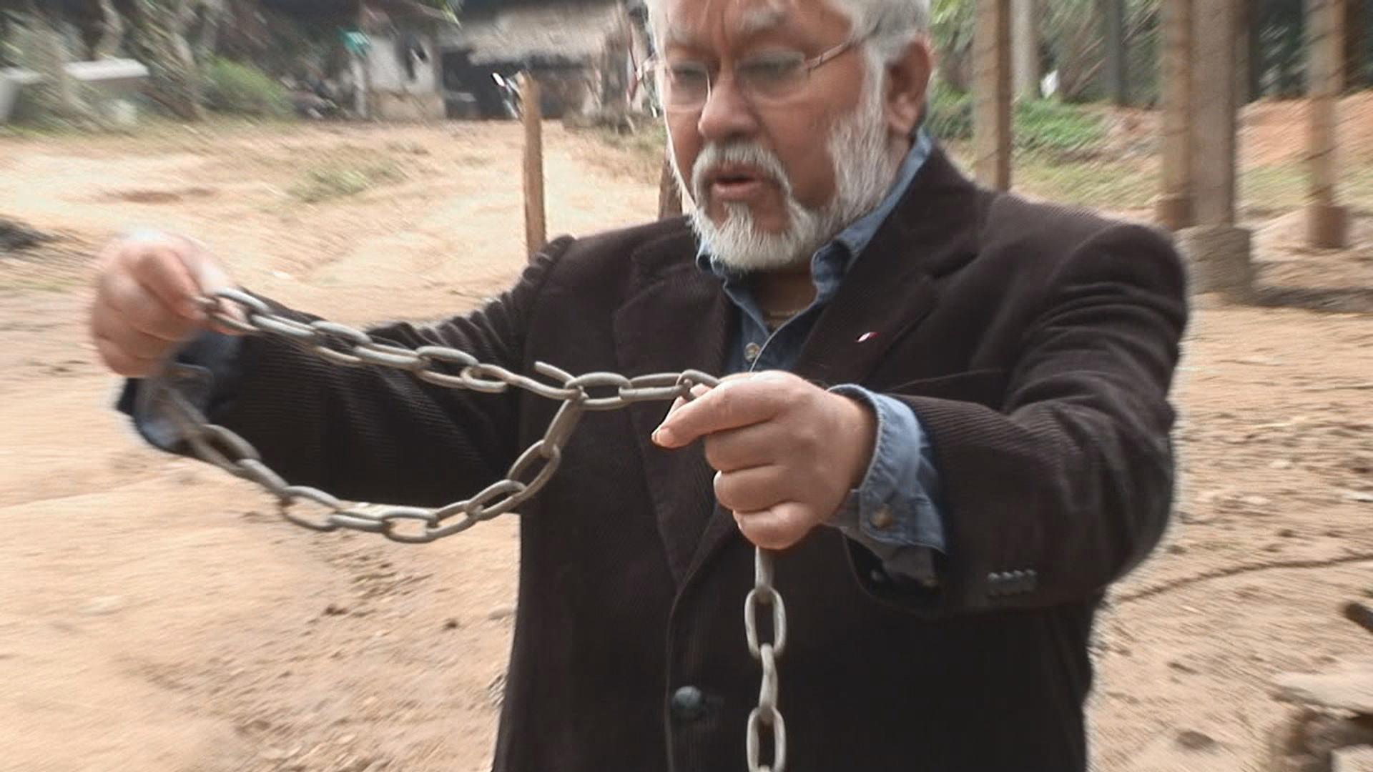

Slide 45
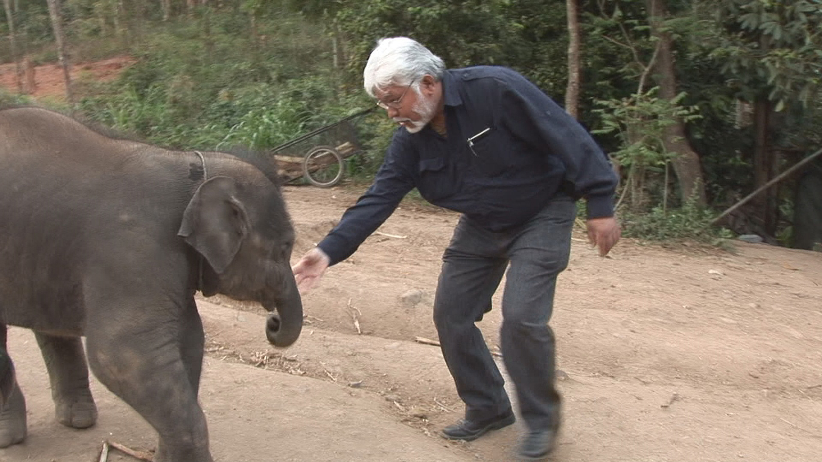

Slide 46
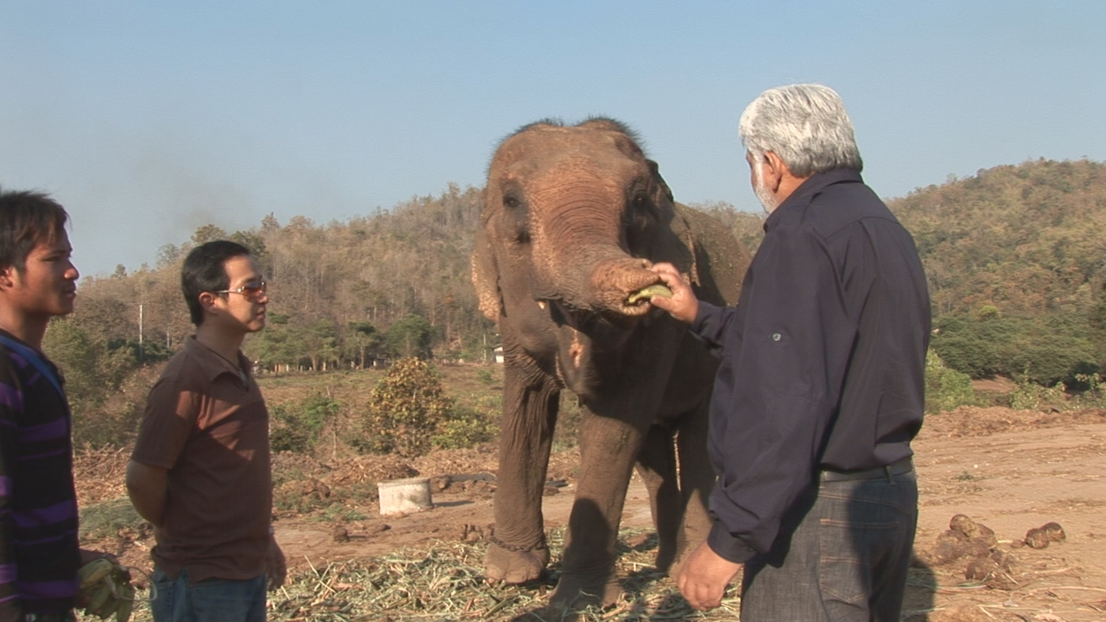

Slide 47
We see the chain as bondage and the elephants sees it differently. He sees it as his security.

Slide 48
When we don't feel the pain of our limitations, we don’t change
It becomes our comfort zone…regardless of how uncomfortable it is

Slide 49
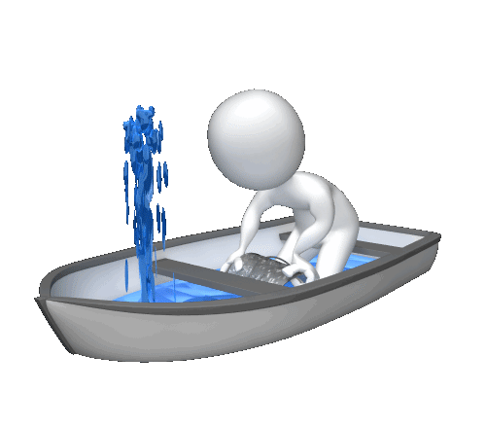

Slide 50
The elephant whose one foot is tied to a chain will not break the chain because he doesn't understand freedom.
The chain itself has become its freedom.
The occasional break of the chain for playing is like a vacation and then it wants to get back its chain.

Slide 51

Awakening to the Nishiiyuu Way and forming a new self image – breaking the chain

Slide 52
As advised by Abraham Bearskin, The Nishiiyuu Way according to the ancestors is as follows:
We see the one spirit, Tshyamendo, in its entirety in all things.
All things is Tshyamendo.

Slide 53

The earth, the sky the trees are one with man.

Slide 54

Unity
The Nishiiyuu Culture is totally based on Unity.

Slide 55
It is therefore impossible not to be successful provided we awaken the realization of our identity.
We become invincible; we become the founding stones of the new building in the mind of all Eeyou/Eenou.

Slide 56
The Cause of our current conditions
All emotional problems, spiritual, physical is caused by the loss of identity. No roots, no fruits.
This course in transformation is the discovery of the Nishiiyuu identity and not the regaining of identity.

Slide 57
The world approaches human development from an external point of view.
They see the individual subject to his/her environment.
They say, “change the environment and you change the individual”.

Slide 58


Slide 59
If that was true …
We wouldn't have criminals in seminaries and churches.

Slide 60
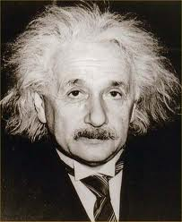
If that was true..
We wouldn't have an Einstein, a telegraph office worker and recommended by his teachers to drop mathematics …and who became one of the greatest scientists

Slide 61
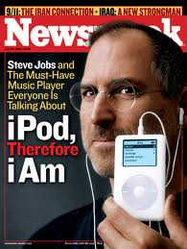
We wouldn’t have a Steve Jobs who was adopted twice and who has played a major role in shaping our world.

Slide 62

The Nishiiyuu Way according to Abraham Bearskin…

Slide 63
The Nishiiyuu Way according to Abraham Bearskin…
The Spirit creates the environment.
The Personality is the vehicle of Spirit.
Change the Personality, you change the environment.

Slide 64
We will change our Personality by…
Focusing on the Nishiiyuu 7 Rites of Passage with the 4 Step Path to Personal Development
Developing a Nishiiyuu personality of courage, bravery, valour, tenacity, resolve, fortitude, decision and will, the very backbone of the Nishiiyuu way of life.

Slide 65
The Nishiiyuu Way is the way of our Ancestors for personal development and growth
It is a holistic system of developing a person from Pre-Conception to Conception/Birth, Childhood, Youth, Adulthood, Elder and merging back with the Universe.

Slide 66
Each of these stages is called “Passages” and each “Passage” has its rituals and systems to develop a powerful, complete and a whole person.
These are called “Rites of Passage”. (Bearskin, 2011)

Slide 67
The Nishiiyuu Way
According to Abraham Bearskin, The Nishiiyuu Way is the Rite of Passage of spirit from:
Prior to Conception
To Conception/Birth
To childhood
To Youth
To adulthood
To Elder
And finally death which is transformation and not a finality

Slide 68
This Personal Development Program will Work
The Nishiiyuu Program, is on the basis of developing the individual, nurturing the spirit within each individual to greatness
The developed individual will create his or her circumstances and environment and not vice versa.

Slide 69
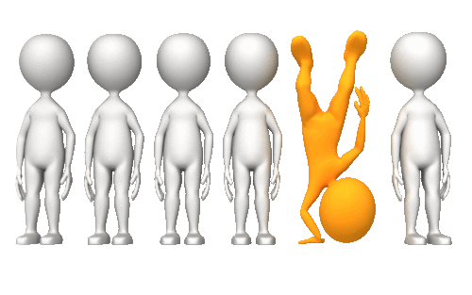

Slide 70
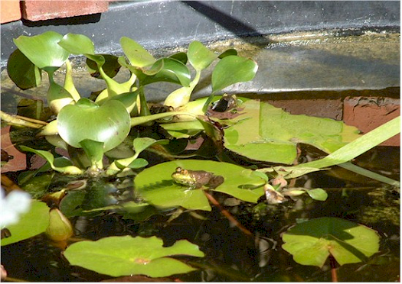
Our Mindset is the size of our world
The Story of the Frog of the Well (The world we live in now) and the Frog of the Ocean (Nishiiyuu)

Slide 71
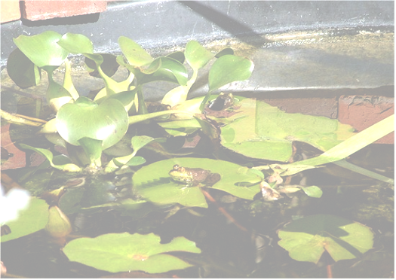
There was this frog born in a well and raised in a well. Did not know that anything existed outside the well.

Slide 72
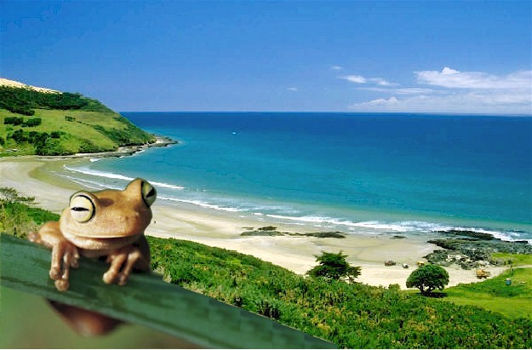
Then on one memorable day.
The frog of the ocean came to visit the frog of the well.
This is just a story. We know that there are no frogs in the ocean.

Slide 73
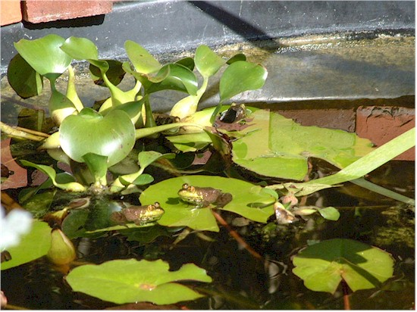
The frog of the well asked,
“How big is your ocean?
“It is bigger than this well”, said the frog of the ocean.

Slide 74

The frog of the well laughed.
“How much more bigger than this well?
Twice the size?
Three times the size?”
Very condescendingly.

Slide 75
The frog of the ocean replied,
“Millions of wells like this will not even suffice. It will get lost in the ocean.”

Slide 76
“I must see it to believe it.”
The frog of the well laughed again.

Slide 77

So they went on a journey to the ocean.

Slide 78
Expansion of the Mind.
As they approached the ocean, and the frog of the well saw the ocean, his mind expanded.
He realized that there are other worlds and other dimensions.

Slide 79
His mind opened up. He was ready to enter into his own being and dive into the infinite power of his Stillness.
To live an unlimited life.
To do that he now must change. A metamorphosis must take place.
He was ready.

Slide 80
The Nishiiyuu Self Image…the Metamorphosis

Slide 81
The greatest gift of a human being is their gift to choose
The Western way of choosing is on the basis of environment and conditions surrounding the individual.
That is not really a choice.
At the most, they are just alternatives or alternates between this or that or multiple choices. This is not the freedom of choice.

Slide 82
Awakening To Nishiiyuu and Forming a New Self Image
The Nishiiyuu Way or the Eastern Way is the freedom to choose without depending on conditions.
The Nishiiyuu Way says that the individual creates his or her environment and conditions because every individual is the individuation of one Spirit and therefore not limited by environment and conditions. …Abraham Bearskin

Slide 83
Changing Thought Patterns
A Metamorphosis

Slide 84
“What the Caterpillar calls the end of the world, the Master calls the Butterfly.”
… Matthew Arnold
Transformation starts with Dissolution
Change is traumatic…just ask the caterpillar
A change from Western thought patterns to Nishiiyuu thought patterns

Slide 85
We too have to break up our old Self Image, just like the caterpillar
And meditate, that is watering our “Self” with the Spirit of Nishiiyuu. The watering is done in quiet contemplation ...
“Who am I?”

Slide 86
The answer will come in a clear voice … “I am that.”
“I am.”

Slide 87
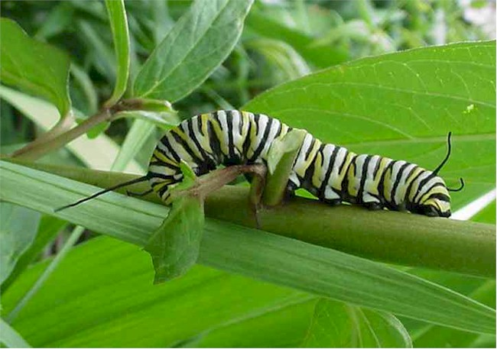
The Awareness of the Caterpillar

Slide 88
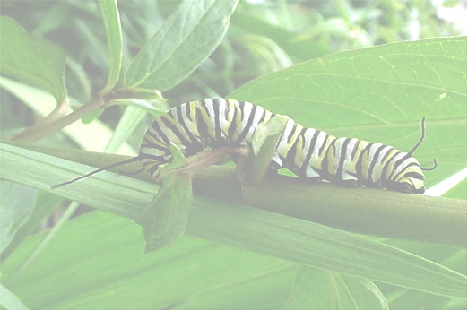
It crawls. It only crawls. Eats the leaves all day long.
It excretes as it eats.
The awareness of the caterpillar with many legs:

Slide 89
It is not aware of the possibilities.
Victim of the birds.

Slide 90
When a slight awareness comes, it realizes it has to know more.

Slide 91
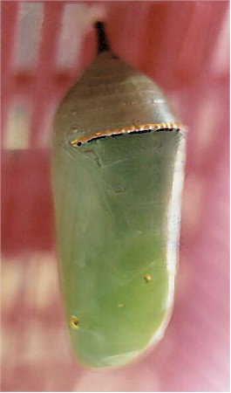
It enters into Stillness.

Slide 92
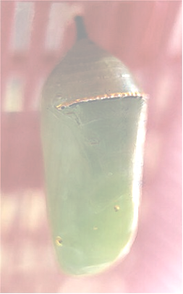
Forms a Cocoon around itself.

Slide 93
It Visions all its possibilities.

Slide 94
This leads to awareness of itself.

Slide 95
Self Awareness
The possibilities.
It’s infinite power.

Slide 96

Unfolds into a Monarch Butterfly

Slide 97

It does not crawl anymore.
It does not eat leaves anymore
It does not even eat the flowers.

Slide 98
It drinks the nectar of the flowers.
Oh no,
It drinks the nectar of life.

Slide 99
He She knows the answers to the question ... Who Am I? This is the Nishiiyuu Way

Slide 100
What the caterpillar calls the end of the world, the Master calls the butterfly.
… Matthew Arnold

Slide 101
Homework
Create one single aim and set one goal

