Slide 1
Nishiiyuu Life Skills Personal Development Program
Day 3

Slide 2

Principles of Nishiiyuu Way
Setting goals from inside out and not outside in

Slide 3
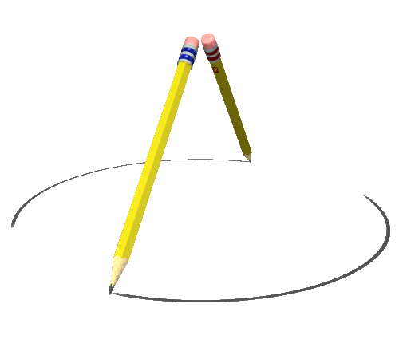
The Process of Visioning – Finitizing the Infinite

Slide 4
The Circle

Slide 5
Concentric Circle
.

Slide 6
Concentric Circle
Con means with
Centric means with the same center

Slide 7
What is a Circle made of ?
Circumference
Radius
Diameter
All you see in the circle is the circumference and we call it a circle.

Slide 8
The heart of any Circle is the center
…And the center is never seen unless it is pointed out
… Without the center, there is no circle.

Slide 9
Yet, the center is invisible
Yet, all the visible things come out of the invisible.

Slide 10
Circumference is equal to circumstances
Every circumstance has a cause and the cause is the center.

Slide 11
The power that generates the circumference is the center
The center is our Being which has created our circumstances.

Slide 12
That is the in – visible.
Visible inside you
Circumference or circumstances are the visible, that is what we call the circle.

Slide 13
You can’t have a visible without the invisible.
What is visible inside must become visible outside.
The center generates the circle.
The Center is static.
The Circumference is dynamic.

Slide 14
Your being is the Center
Your I am is the center
Your circumstances are the circle
The center is Tshymendo
The circle is the creation

Slide 15
All creation comes from the center to the circumference in a spiral form which is called a vortex.

Slide 16


Slide 17
The wind moves in a spiral motion; in a vortex
The human body, conceived from one cell, moves in a spiral motion to develop a whole body from the belly button (navel chord).

Slide 18
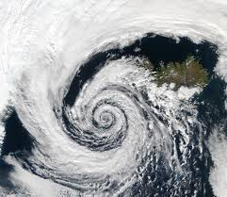

Slide 19
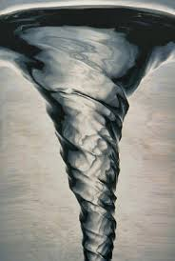

Slide 20
The moon goes around the earth, and the moon along with the earth, spirals around the sun
The sun is the center

Slide 21
A flower blooms in a spiral, a vortex.
The leaf unfurls in a spiral
The tree grows in a spiral
The universe works uniformly, all motion is the same motion.

Slide 22

The Fern unfurling

Slide 23


Slide 24
The galaxy moves in a spiral.
Everything is circular.
Everything moves in a curve.

Slide 25


Slide 26
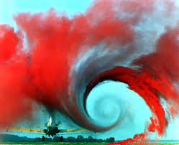

Slide 27
This delightful, mighty intelligence is the center of your being, Tshymendo
When you vision, you put this mighty force into action.
This force is infinite power.
There is only one force, one infinite power.

Slide 28
So, when you sit down to vision …
See what you want to be
See what you want to do
See what you want to have
This is the only force.
There is no other force is available.

Slide 29
Circle of Dissolution, Evolution and Preservation
Dissolution of the seed is the evolution of the tree

Slide 30
7 Steps of Building a Dream and Making it into a Reality

Slide 31
7 Steps of Building a Dream and Making it into a Reality
Intention
Attention (Concentration)
Imagination
Order/Reason
Intuition
Self Reliance
Manifestation

Slide 32
1. Intention
The Mainsprings of Mental Machinery:
Desire
Expectancy
Enthusiasm
Unbending Intention
in = means towards
Tendre = means stretch
Stretch Towards

Slide 33
Intention Creates Reality

Slide 34
2. Attention (Concentration)
Means gathered at a center
Focused

Slide 35
3. Imagination
Seeing it being done.
Feeling the ecstasy of accomplishment
Imagination is the most powerful tool
Yield not your Imagination to your limited mind!

Slide 36
Genesis 1:1-1:2
1:1 In the beginning God created the heaven and the earth.
1:2 And the earth was without form, and void:

Slide 37
John 4:35
“Say not ye, There are yet four months, and cometh harvest? Behold, I say unto you, Lift up your eyes, and look on the fields; for they are white already to harvest.”

Slide 38
Mark 11:24
“Therefore I say unto you, What things so ever you desire, when ye pray, believe that ye receive, and ye shall have.”

Slide 39
“As a Man thinketh is his heart so is he”.

Slide 40
Doubts Will Come
Proverbs 3:5
“Trust in the Lord (I Am That I Am….Being….Jehovah….IHVH) with all thine heart; and lean not unto thine own understanding.” (Intellect)

Slide 41
4. Order/Reason
Organizing Chaos outside you into your Cosmos (Order)

Slide 42
Your Brain (Computer) is now allowed to work
You load your computer with the data, it puts it in Order

Slide 43
A One-Pointed Vision can only take place when the Vision and the Imagination are Organized

Slide 44
Keep working on your present circumstances as required by you now… efficiently.
Present circumstances are perfect … as it should be.
It has brought you here now.
Don’t push it!
Accept it!
Take Responsibility!
Don’t Blame!

Slide 45
5. Intuition
There are voices
There is only one strong, clear Voice
Listen with your heart
Do not listen with your mind.

Slide 46
Intuition
Inner – Tuition
The Master (Inner Teacher within)

Slide 47
Intuition is Not Hunches
Intuition is a clear instruction
This Inner Teacher is in touch with every point in space and time for you … Listen to it.
You will be experiencing your beingness prior to manifestation
Doubts (Pests) will be eliminated.

Slide 48
Total Reliance on Your Consciousness for Accomplishment of Your Vision
Do not depend on your senses, but make full use of your senses.
If you have a tendency to rely on your senses, then practice going back to your Intention, Attention and Imagination.

Slide 49
6. Self Reliance
All Reality is but the Fruits of Vision and Imagination
This is called Self Reliance

Slide 50
The Real is Your Own Feeling – Intention – Attention – Imagination – Order – Intuition – Self Reliance

Slide 51
7. Manifestation
You will see and feel and hear and taste and smell with your senses what you intended and imagined.

Slide 52
Manifestation
Hold your will in a receptive position
In thought, word and deed, rely on your Consciousness

Slide 53
Preparation For Visioning
…After acceptance of the fact that Consciousness creates.

Slide 54
Feeling
Thought
Form

Slide 55
Stand Aside as a Witness and ask and then observe objectively.

Slide 56
Ask:
Where is your feeling being generated from?
Is your feeling a reaction to your circumstances?
Are you battling your circumstances?
Are you enhancing your circumstances?
Do you want to create whole new circumstances?

Slide 57
Eradicate Self Condemnation
Condemnation of your present circumstances
Condemnation of the world and its treatment of you

Slide 58
Practice Every Moment
Live

Slide 59
Create a Blue Print For Your Life
Mind mapping a Vision with Mind Mapping Software
Freemind Software download for free at http://freemind.sourceforge.net/wiki/index.php/Download

Slide 60
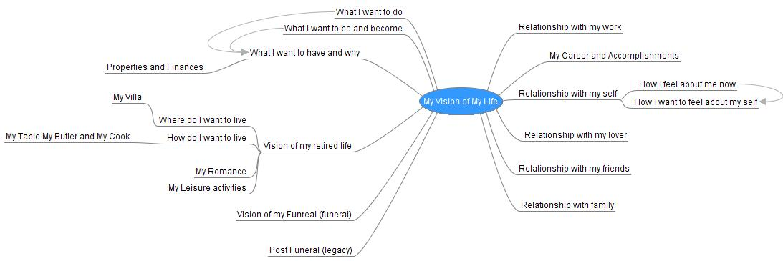
Mind Mapping Your Vision

Slide 61

Attitudes and Decision Making
Independence, Interdependence and Co-Dependence

Slide 62
Each Decision we make determines the quality of our lives
All our actions and behaviour should be in harmony with purpose
The realization that we are all one, what I do to another, I do to myself
In thought, word and deed to live the Nishiiyuu Way

Slide 63


Slide 64
Our Self Image determines our attitude of Independence, Interdependence and Co-Dependence
We don’t get what we want, we get what we are – our beingness
The Nishiiyuu Way of right speech – “What you are speaks so loudly I cannot hear what you are saying”.

Slide 65
Our Attitudes determines Our Altitude
What are your expectations?
We cannot act in one way and expect another
You cannot trick the Universe, you cannot be anxious and worry and expect your vision to manifest…you are expecting the opposite
You cannot plant a plum tree and expect apples

Slide 66
Developing Relationships and Resolving Differences the Nishiiyuu Way
Communications is a two-way traffic. Listening and responding. Speaking and listening.
The difference between hearing and listening.
Thinking before talking.
The difference between reaction and action.

Slide 67
The Nishiiyuu Way of Communication
You enter into each situation, each relationship knowing what you want before you enter
You see it inside you before it is expressed outside
You are detached to the results
You will be amazed how different the results will be

Slide 68
The Nishiiyuu Way of Communication
Assertiveness as opposed to arrogance and being stubborn
The cause of anger in general is from obstructed desire to be expounded
Avoiding conflict and if there is conflict how he/she can resolve the differences before sunset (conflicts grow faster in the dark).

Slide 69
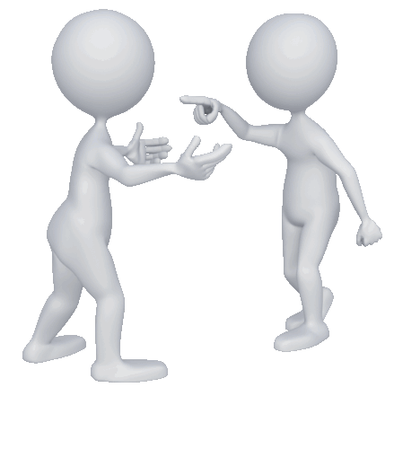
This is not the Nishiiyuu Way

Slide 70
Family Personal Interrelationships and Communications
Communications at all levels with the family
Understanding and listening to the needs and desires of each member of the family.
Communication is the artery through which the relationship flows. The process of understanding other’s desires and communicating the Individual’s desire to the whole family.

Slide 71
Day 3 Homework
You are already a brilliant Manifester
Take 30 minutes and write down all the things in your life, good or bad, that you have manifested in your life
You will prove to yourself that you already are a brilliant manifester
This will increase your belief in your ability to manifest

