Slide 1
Nishiiyuu Life Skills Personal Development Program
Day 2

Slide 2
Living a Life on Purpose
Setting Goals and Visions
the Nishiiyuu Way

Slide 3

























The Nishiiyuu Way
Nurturing the Nishiiyuu Roots
7 Rites of Passage
Pre-Conception
Conception
childhood
Youth
Adult
Elder
Death
Right Understanding
Right Purpose
Right Speech
Right Actions and Conduct

Slide 4
Roots of the Tree determine the strength of the Tree
Strong deep roots and the tree can withstand any outside onslaughts
No roots, no fruits

Slide 5
The Way Of Our Ancestors Pre-Contact For Today’s Living
The Nishiiyuu Way Agreement
This document was started by the Council of Chishaayuu Elders to create a document to back up the Trainers for their work as Nishiiyuu Trainers.

Slide 6
The Starting Document
What is the Nishiiyuu Way?
Answer:
There are 2 types of beliefs:
There is one God or
That God is One
The Nishiiyuu Way belief is that God is One who we call the Creator or the Great Spirit or Chiishaaminituu.

Slide 7
“We live, move and have our being in him”,
The Nishiiyuu Way
Without Free Will there is no spirituality

Slide 8
Values of the Nishiiyuu Way
Free Will
Love
Respect
Truth
Acceptance and Universal Tolerance

Slide 9
Values of the Nishiiyuu Way
Living in freedom and peace
Without judgement of others is the premise of The Nishiiyuu Way of beliefs
The Nishiiyuu Way is self-responsibility, self-reliance and self-respect
Sharing and helping each other

Slide 10
Values of the Nishiiyuu Way
Humility and integrity
Gender Equality
Equality according to capacity and capability
Balance and harmonization with all Creation – all living animals and every living thing

Slide 11
Values of the Nishiiyuu Way
Know the gifts the Creator gives you, they are all in you.
You are a witness on behalf of Chiishaaminituu and speak on behalf of Chiishaaminituu, the voice of Chiishaaminituu which encompasses the earth. Why you were given the gift of sight and sound.

Slide 12
Values of the Nishiiyuu Way
All that you have is sacred and how to use those gifts in a sacred manner. You walk your talk.
Protocols of mating, whether human or all living thing are the same.

Slide 13
Values of the Nishiiyuu Way
Protocols of hunting and respecting the animal, offering before and after the feast.
Faith, hope and love, and number one is love. Love brings faith and hope.

Slide 14
The Nishiiyuu Way is the Way of Our Ancestors.
The Nishiiyuu Way is setting aside our ego and living life with acceptance and tolerance of all Peoples beliefs and cultures.

Slide 15
The Nishiiyuu Way is not passing judgment on other’s behaviours, respecting all life whether human or otherwise.
The Nishiiyuu Way accepts and believes that everything and everyone is spirit.

Slide 16
The Nishiiyuu Way actions shall not in any way diminish or harm our spirit or another’s spirit in any harmful way.
The Nishiiyuu Way is totally accepting and being proud of whom we are and not coveting the ways of other cultures.

Slide 17
The Nishiiyuu Way is being in balance spiritually, emotionally, physically and mentally.

Slide 18
Creating a New Nishiiyuu Mindset
Combating Anxiety and Despondency the Nishiiyuu Way
A crucial step before one can even set Goals and Visions for one life

Slide 19
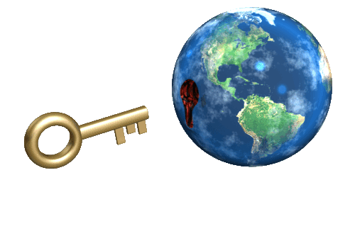
Free the Mind the Nishiiyuu Way
Steps to Stillness (Mindfulness)

Slide 20
Step 1 – Right Understanding
Clear understanding of the principles and philosophy that we are going to apply
The Nishiiyuu Way of life and how it was lived before is to be understood
Insight into the self-identity and the power of the individual in relation to the environment and circumstances

Slide 21
Step 2 – Developing Purpose
Setting goals and Visions the Nishiiyuu Way

Slide 22
Step 3 – Right Speech
Unspoken Speech, Thought and Spoken Thought
Speaking kindly, acting kindly, living not only for oneself but the welfare of all
Thought and word to be maintained in harmony with vision and purpose

Slide 23
Step 4 – Right Actions and Conduct
All our actions and behaviour should be in harmony with purpose.
In thought, word and deed to live the Nishiiyuu Way

Slide 24

Story of the Frog and the Scorpion

Slide 25
How To Raise Belief Level with the Nishiiyuu Way
The Western way of personal development is to change the circumstances to change the person.
The Nishiiyuu Way is to change the person to change the circumstances.

Slide 26
How To Raise Belief Level with the Nishiiyuu Way
In the Western way, the mind makes the person and their circumstances. They say that man is mind.
In the Nishiiyuu Way of personal development, spirit creates the mind and the mind controls circumstances.

Slide 27
How To Raise Belief Level with the Nishiiyuu Way
This is the complete reversal of the Western system where the mind controls the person and not the person that controls the mind as is the Nishiiyuu Way.

Slide 28
How To Raise Belief Level with the Nishiiyuu Way
In the Nishiiyuu Way, the person determines their destiny, in the Western way the person journeys towards their destiny determined by their circumstances.
In the Nishiiyuu Way the person realizes that they are invincible because they are spirit.

Slide 29
Nishiiyuu Way is the way of the Future
The world is secretly terrified of the future.
It is not the nuclear weapons that are as fearful today as much as the artificial intelligence and the robotic world which has begun to take control of our lives.

Slide 30
Nishiiyuu Way is the way of the Future
The Nishiiyuu Way is the way to freedom, the realization that everything is spirit.
That each one of us can be anything we want to be and that we are the author of all intelligence as we are Spirit.

Slide 31
A New Nishiiyuu Mindset for a Healthy Body and Healthy Mind and Prosperity
It will empower the individual from inside out and not from outside in.
The realization that all the power that ever was or will be is inside each one of us now and is the tipping point for success and growth from where we are at now.

Slide 32

The Nishiiyuu Way is the way of life and liberty

Slide 33
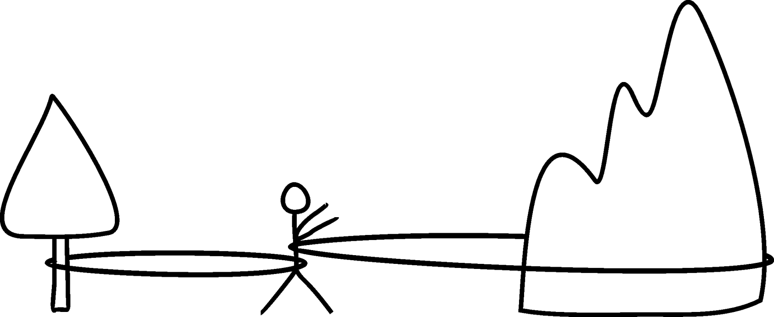
Personal Development
Past Conditions and Circumstances
How You See Yourself Today
Goals and Vision

Slide 34
Goals and Visions the Nishiiyuu Way
You don’t get what you want, you get what you are
Goals and Visions define a Person
You cannot desire what you are not

Slide 35
The Nishiiyuu Way – Dreamers in Action
When you have the pathway to be what you want to be, you concentrate on the path and on fulfilling your dreams.
When you have no pathway, you will have a tendency to focus on your anger and on your regrets and live in the past. It is self-destructive.

Slide 36
Story of the Dream Catcher

Slide 37


Slide 38
Many people to become successful create visions of having and then doing, then being. It never works that way. It is the reverse.
They say, “Once I have what I want I can then be it”.

Slide 39


Slide 40
Being and doing creates having….and not vice-versa
The Nishiiyuu Way to Setting Goals and Visions

Slide 41
Nothing can ever manifest without a vision.
Prior to manifestation there is always a vision.
The word “Prior” means before and it is a derivative of the word prayer.

Slide 42
The spirit visions from the limitless world, because spirit is limitless.
The mind holds the vision when it is able to believe in it.
Then the whole universe bows to the vision and gets to work to manifest it as it is already formed in the spiritual world.

Slide 43
There is an unfailing correspondence between what is inside you and what is outside you.

Slide 44
Your state of mind, your being-ness, and all thoughts manifest as earth, as things, unless cancelled by an opposite thought.
Then that opposite thought produces the thing.

Slide 45
Thought and Creation Happen at the Same Time, It Is Not a Future Event
What you think today, your state of mind, your being-ness at this moment, are things already in existence waiting for your sensations to understand that it is already manifested.

Slide 46

Why is it so difficult to believe that our vision creates our reality?

Slide 47
Your sensations haven’t realized physically, what you call “physically,” that it is already manifested.
What happens when you don’t see and sense things “physically”?

Slide 48
Every thought produces things instantly but your five senses do not touch, taste, feel, smell and see it.
Your sensory organs have not been developed to see the manifested aspect of your thought.
Therefore you deny its existence.

Slide 49
By denying its existence you cancel that thought and produce what you have just thought instead.
Then you wonder why your thoughts are not creating the thing that you’ve thought about.

Slide 50
Everything you see around you was created out of thought.
You never do anything, you see it being done already, then it is done.
The world is realizing this absolute Truth.
This is the Nishiiyuu Way

Slide 51
Today, scientists are confirming what Nishiiyuu taught.
Quantum physics confirms that the universe is non local, that is, there is no locality between the thought and the thing.
Everything you desire or think about comes to you unmediated, unmitigated, and immediately.

Slide 52
Jesus had poetically enunciated this great scientific law in Mark 11:24,
“Therefore I say unto you, What things soever ye desire, when ye pray, believe that ye receive them, and ye shall have them.”

Slide 53
Today psychologists, scientists, quantum physicists are saying that all things are observer created.
All things are created by observation.

Slide 54
In the last century a great man said,
“Circumstances do not make the man, they reveal him to himself”.
James Allen
And Solomon says, “As a man thinketh in his heart, so is he.”
Proverbs 23:7

Slide 55
Knowing this gives you complete freedom to be whatever you want to be, to do whatever you want to do, and to have whatever you want to have.

Slide 56
You are free from all limitations.
You are the master of your world.
You are the world.
You create your own world.

Slide 57
As you think, so you are, is explained here in the most profound and powerful way.
And it is a logical explanation.
The relationship between you and the Creator is first established.
Then you are told you are the Creator.

Slide 58
Everything Works by the Scientific Law of Cause and Effect
The cause is your thought.
Thought is the creative force and the only force that creates, and you live in a thought world.
The effects are your environment and your circumstances.

Slide 59
You suffer when you begin to think thoughts as a reaction to your circumstances which is the effect of your previous series of thoughts.
You need to think from your heart and not as a reaction to your situation.

Slide 60

Setting Your Goals and Vision

Slide 61
A Goal is:
The concept of achieving some thing, some conditions, or some circumstances.

Slide 62
A Vision is:
Seeing it already done before it happens, by feeling it.

Slide 63

A fantasy is a vision that you don’t believe in

Slide 64

Person Without A Vision

Slide 65
The most important thing in life, doesn't matter who you are, is to know what you want.
If you don’t know what you want you will be living someone else’s vision
That is why it is so important to have your own vision!

Slide 66
It must be a Vision of what you want and not what you wish.
Want is kingly and a wish is a vision without energy.
A wish is wishy-washy

Slide 67
What Do I Want?
The majority of the people on this planet earth really, really, really don't know what they want.
What they do may not be what they want, and what they do is reacting to every moment and handling the situation without knowing where they are going to.

Slide 68
What Do I Want?
When a person knows what they want they will do the same but they have a different objective, so how they react to the same situation creates a different result because they know their destination, they know what they want.
When you know what you want, you are actually living in that want all the time.

Slide 69
So when you understand your own power, the power of your spirit, The Nishiiyuu, that element that holds you back will be removed
You know you can be whatever you want to be, you can do what you want to do and have whatever you want to have.

