Slide 1
Nishiiyuu Life Skills Personal Development Program
1 Hour Introductory Program

Slide 2

What is this Program About?

Slide 3
This program is focused to give anyone who follows it, the power to set purpose, create vision, and manifest their vision
“Living Life The Nishiiyuu Way”

Slide 4
Purpose of this Program
To create a new mindset, the Nishiiyuu Way, the Wisdom of which is to be transferred and transmitted by the Elders to the Youths and Adults.

Slide 5
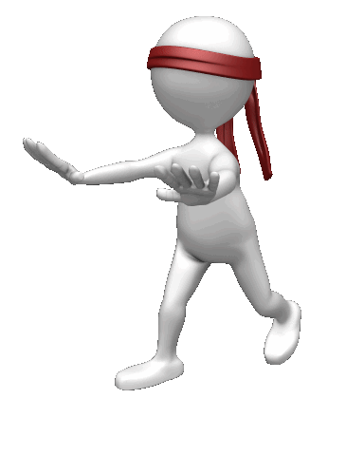
To Help Develop Purpose and Find Their Vision For Life
Many go through life, morning to night, every day without a Vision and Purpose

Slide 6
What is the Nishiiyuu Way?
“The Nishiiyuu Way Personal Development Program empowers the individual by cutting through the debris of their past conditioning and limitations and giving the individual the key to setting purpose by finding their Nishiiyuu identity.
They will re-create themselves and build a positive future with purpose

Slide 7
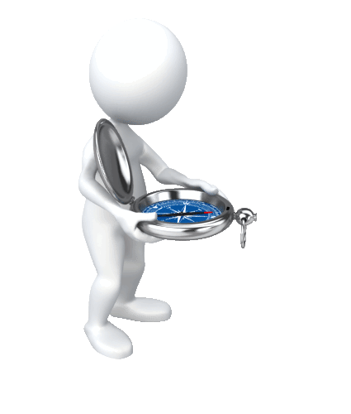
Without Goals and Vision Empowerment is Ineffective
If we don’t know where we are going, the best vehicles cannot take us there
A purpose-less life is excruciatingly painful; we cover it up by being busy with no purpose
"If a man does not know to what port he is steering, no wind is favourable to him“… Seneca
A Vision to Arrive...Port

Slide 8
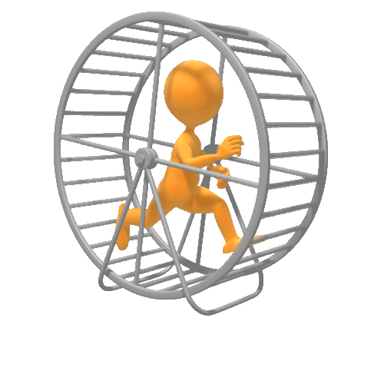
A Person Without A Purpose Goes In Circles; Ends Up In The Same Place
They work hard to go nowhere

Slide 9
The Nishiiyuu Way of Setting Purpose
The greatest gift the Creator has given us….
The Power To Choose
Not only that,
The Freedom To Choose

Slide 10
The Objectives of this Program
Motivate and empower the youth for healthy body, mind and spirit the Nishiiyuu Way
Learn the culture and traditions from the Elders and keep the traditions and culture alive for generations to come
Minimize self inflicted injuries and abuses

Slide 11
Objectives cont.
Reinventing and recreating the sense of values based on Nishiiyuu Self-identity
To break free from the past conditionings of abuse and failures, learn from it with the Nishiiyuu concept and build purpose with renewed strength
To build a life for family and community of health, balance and wealth

Slide 12
Objectives cont.
Self Identity
Understanding other cultures from Nishiiyuu perspective to broaden the horizon and deal with the rest of the world with dignity and respect

Slide 13

Transformation of the Individual
This is a course in transformation of the youth and the adult with our Ancestral Teachings as given to us by our Elders to train the Eeyou/Eenou Region, The Nishiiyuu Way.
Role models will be created to pass on the baton of the Nishiiyuu Way to their children and grand children

Slide 14
There is a saying…
“Tell me I will forget
Show me, I will remember
Involve me, I will understand”
All training will be based on involvement from a Nishiiyuu perspective

Slide 15
You will leave this Program…
Knowing the Nishiiyuu Culture is as great as all the other cultures
Knowing The Nishiiyuu Way will enable you to withstand adversities and grasp opportunities
With pride and respect for your own culture not because it belongs to you, but because it is the truth

Slide 16
You will leave this program…
Discovering your Nishiiyuu Self-Identity and proudly promote your identity to the world
Eager to learn and understand other cultures while staying firmly rooted in the foundation of the Nishiiyuu Culture
Focused with the power to set purpose, create vision, and manifest your vision

Slide 17
You will leave this program…
Being able to set vision not from the limitations of the past but the freedom of the Nishiiyuu Ways
With a new mind set, a Nishiiyuu Way mind as the Elders have advised
Able to maintain your mental balance and calmness in the midst of immense change you face every day of your life

Slide 18

Let’s start….

Slide 19
And It All Starts With… Self Identity.
What you think of Yourself?

Slide 20
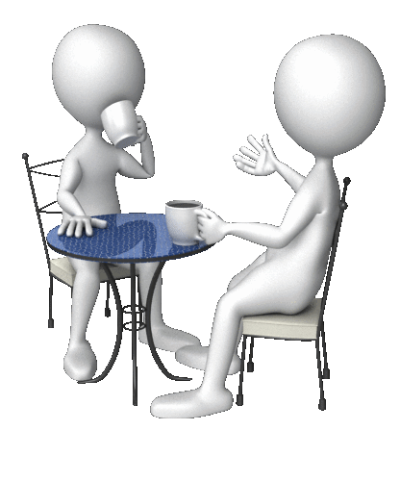
Take a good hard look at yourself

Slide 21
Answer these 3 Questions…
Take 5 minutes now to write down your answers to each of the following three questions

Slide 22
What Do You Want
…To Be?
…To Do?
…To Have?

Slide 23
Liberty is the ability:
To Be what you want to Be
To Do what you want to Do
To Have what you want to Have

Slide 24
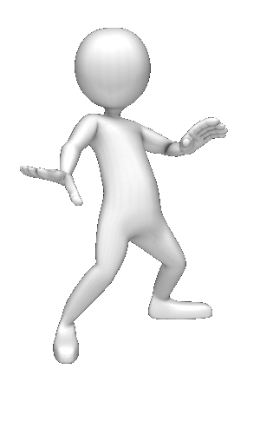
But first to be true to yourself, you have to know your Self Identity

Slide 25
Finding Your Self Identity
Who am I?
What am I doing here?
Where is here?

Slide 26
Ask yourself these questions…
Where am I going to?
What is my Purpose here?
Why do I do the things that I do and the way that I do it?

Slide 27
The answers are…your Self-Image which is your Power Source
Your Self-Image makes you what you are
The sum total of your beliefs & memory, understanding and knowledge

Slide 28
You are totally dependent on your Self-Image for everything you do
That is your unfailing dependency

Slide 29
Your Goals… Your Visions… Your Aspirations …and all your response system is directly limited by your Self-Image

Slide 30
We cannot see or think what we are not
We cannot desire what we cannot be
We are trapped in our Self-Image

Slide 31

How many people approach their life

Slide 32
All the thoughts that you think or capture from the Universe has to filter through your Self Image before it can enter your heart.

Slide 33
If your Self-Image doesn’t agree with the thought that you are entertaining then it will not be permitted to enter your heart
You CANNOT think that thought

Slide 34


Slide 35
If today I told you to think of being a Billionaire, you will laugh at me. Why?
“As a man thinketh in his heart, so is he.” James Allan
Because your current Self Image would not permit this thought to enter your heart.

Slide 36
But if I told a Billionaire that he should be thinking of making another Billion this year he would not laugh, rather he will be entertaining that thought.
Why?
Because he has the Self Image of a Billionaire. His Billionaire Self Image will allow the thought of making another Billion to enter his heart.

Slide 37

So how Is our Self Image Formed?

Slide 38
V
O
J

Slide 39
V … Voice
O … Of
J … Judgment

Slide 40
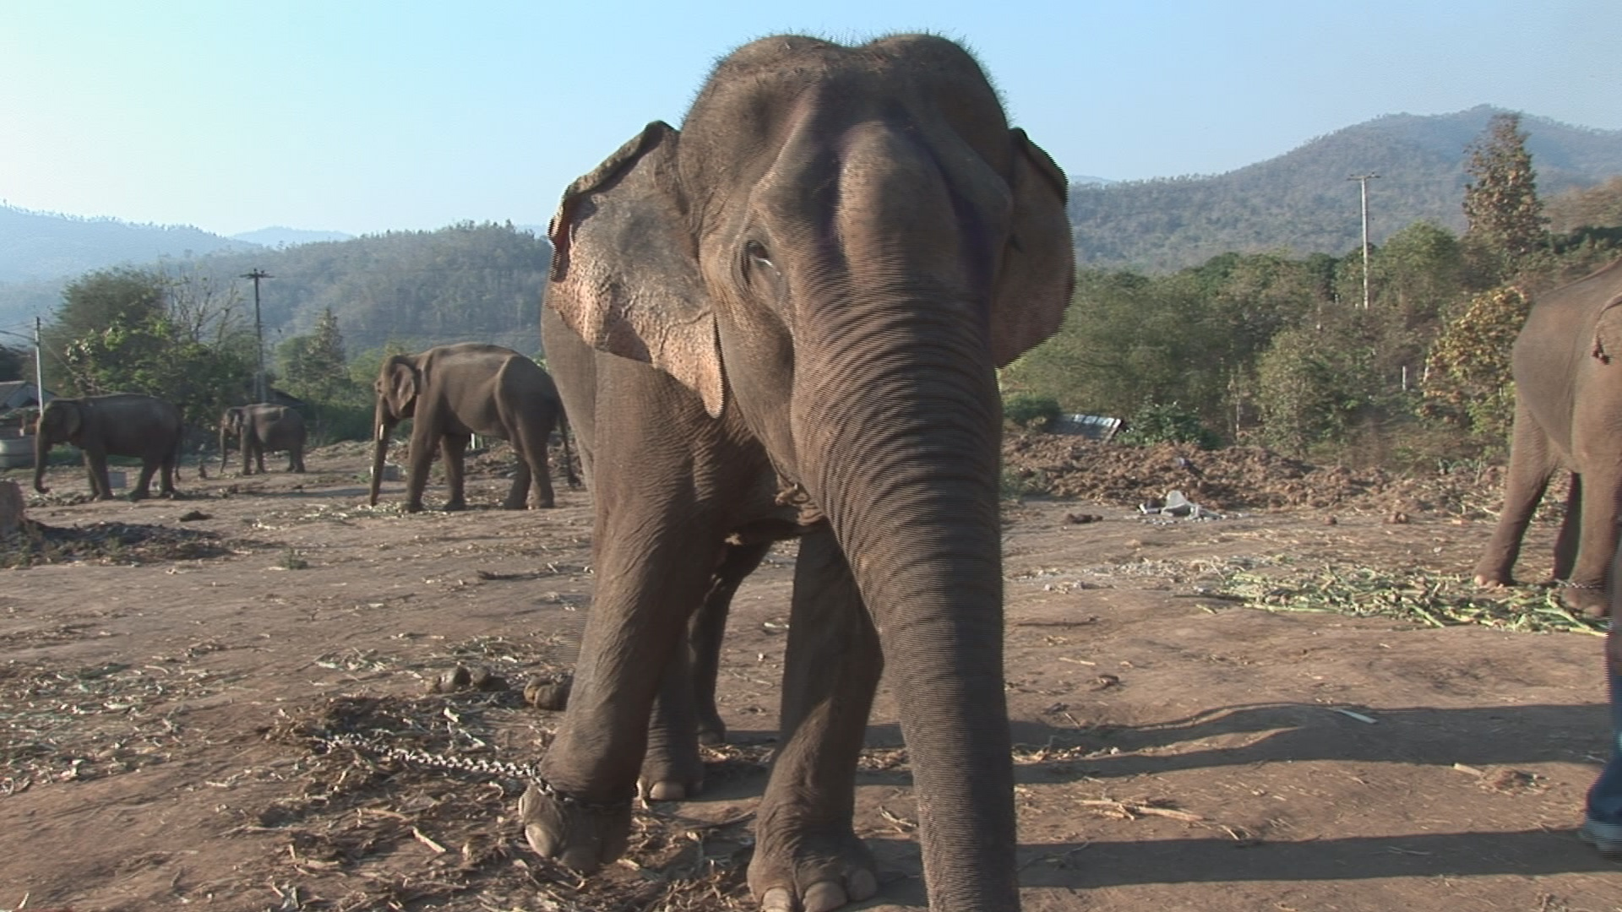

Slide 41
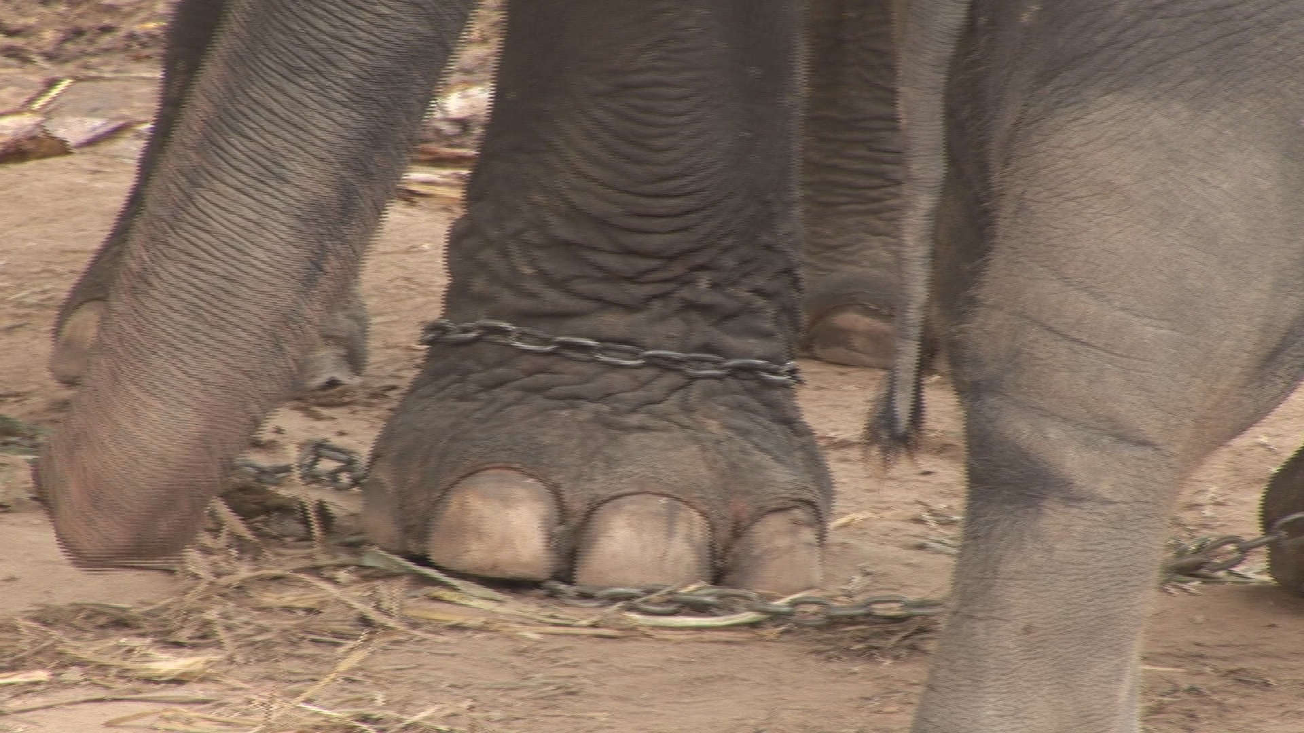

Slide 42
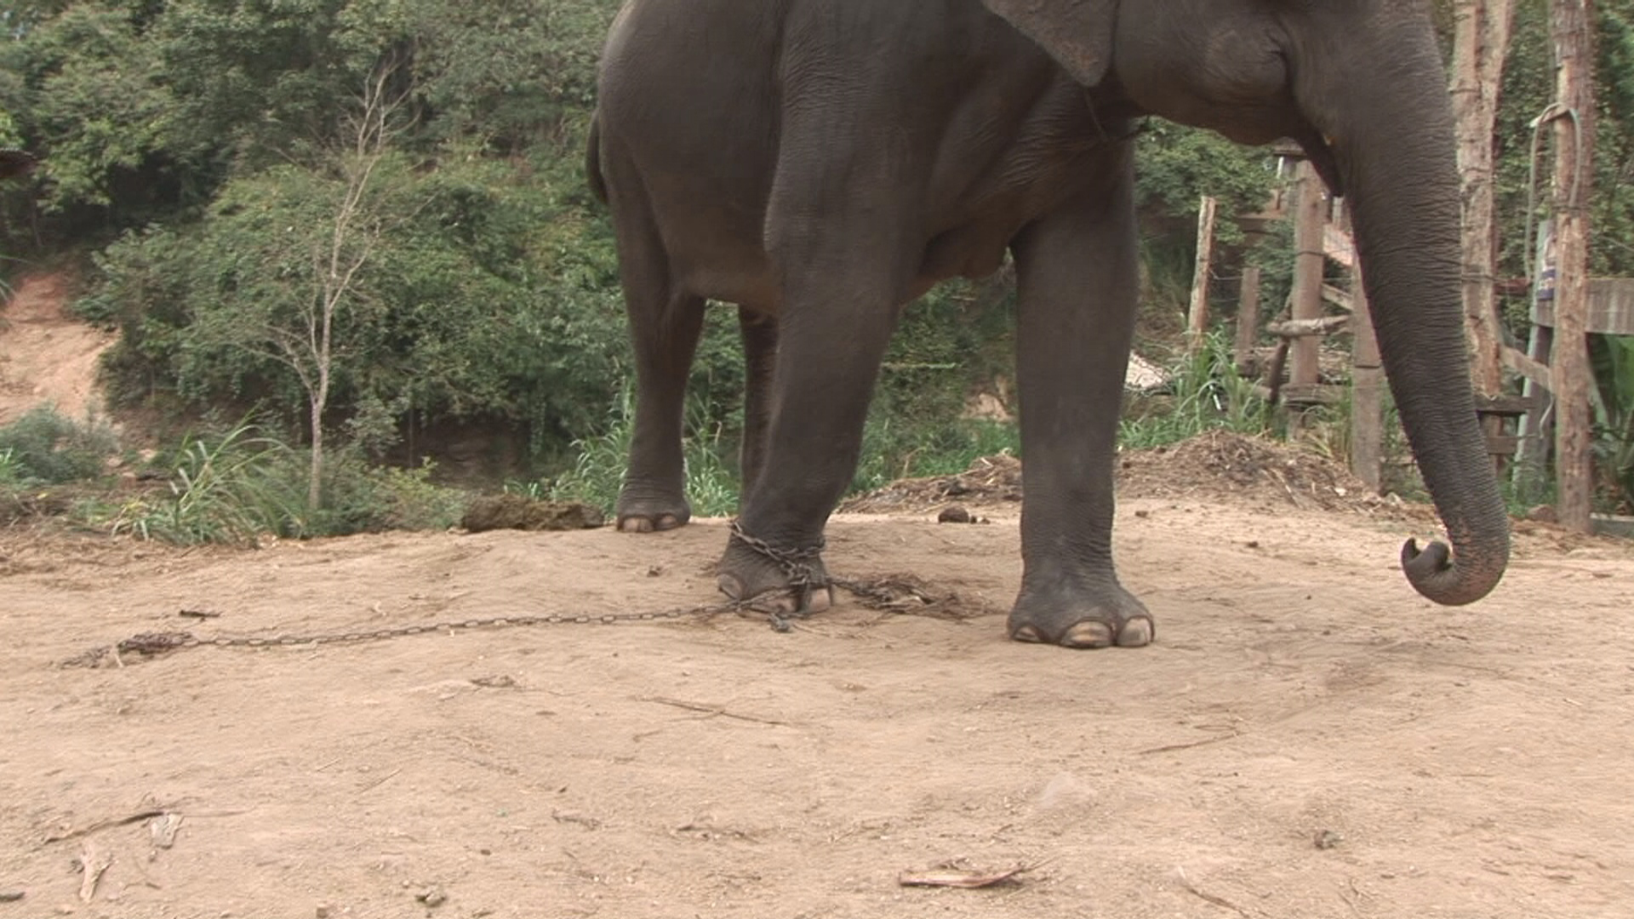

Slide 43
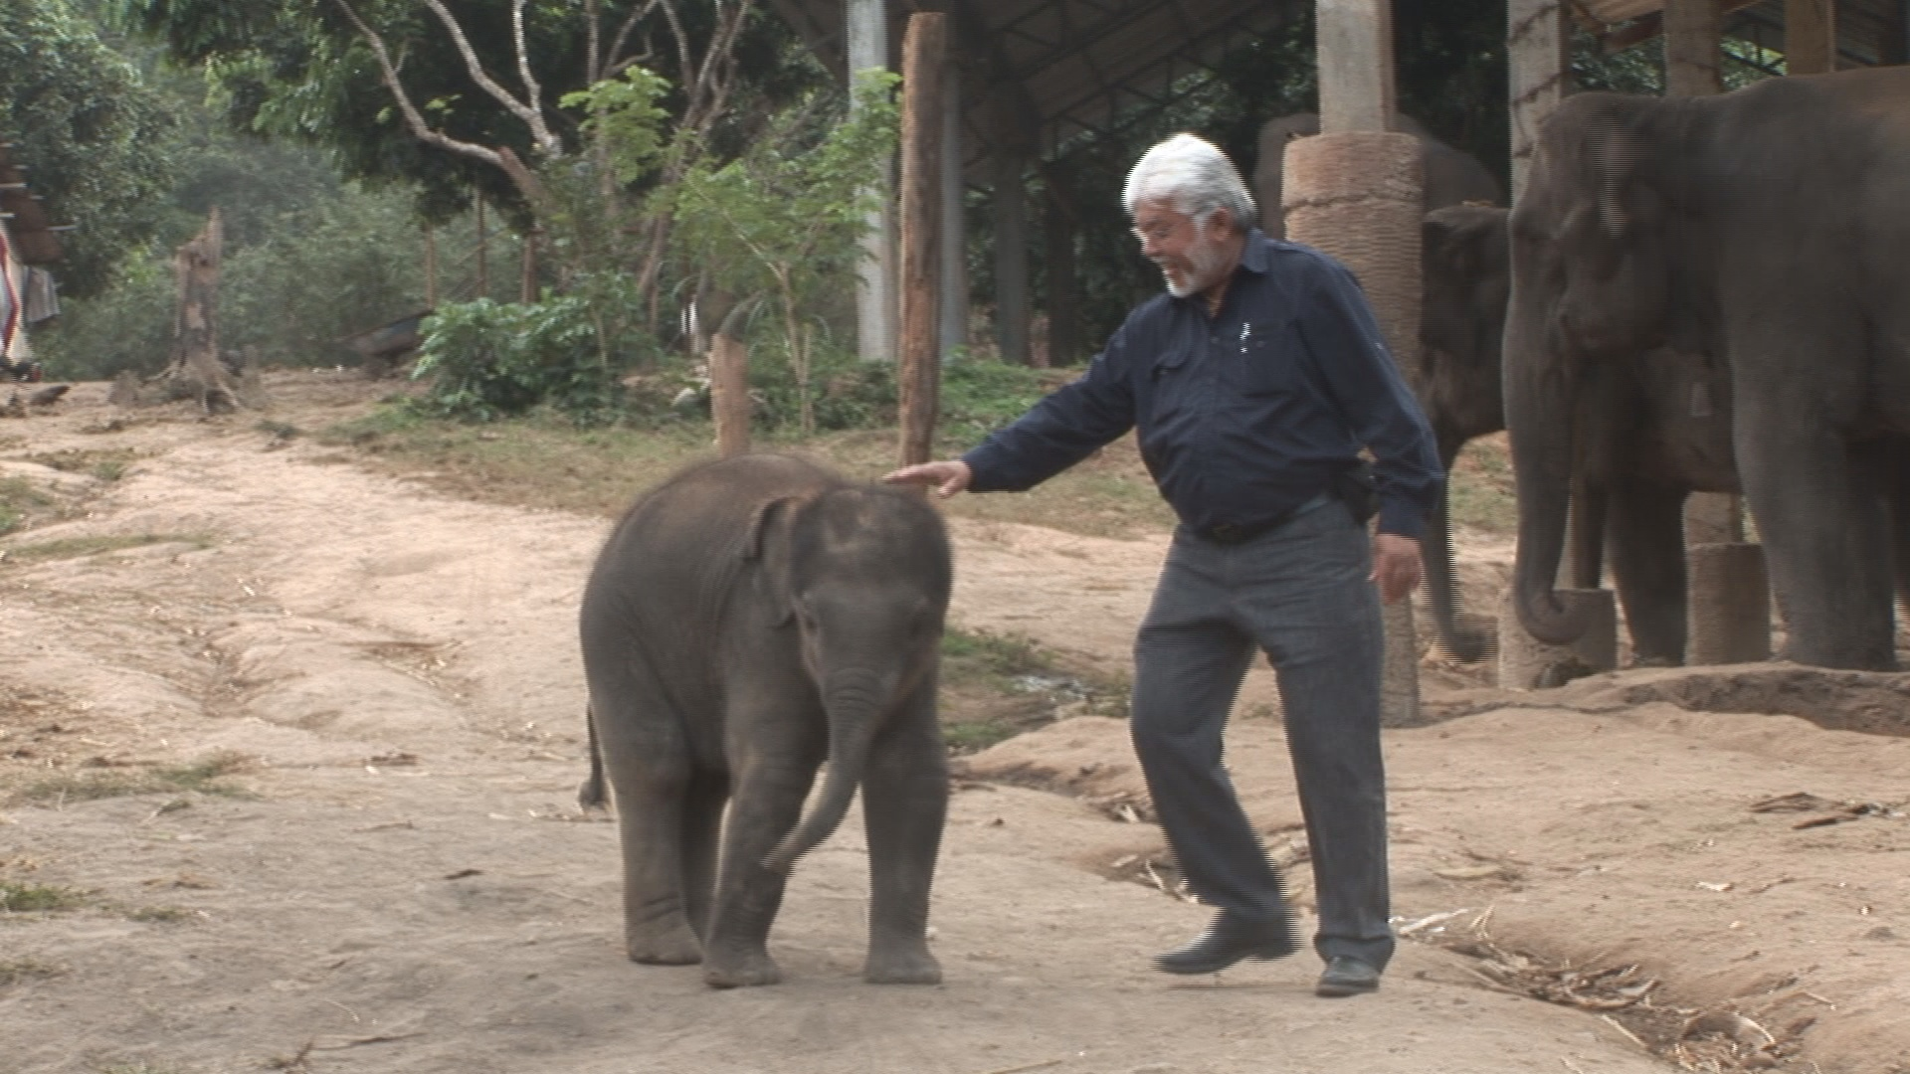

Slide 44
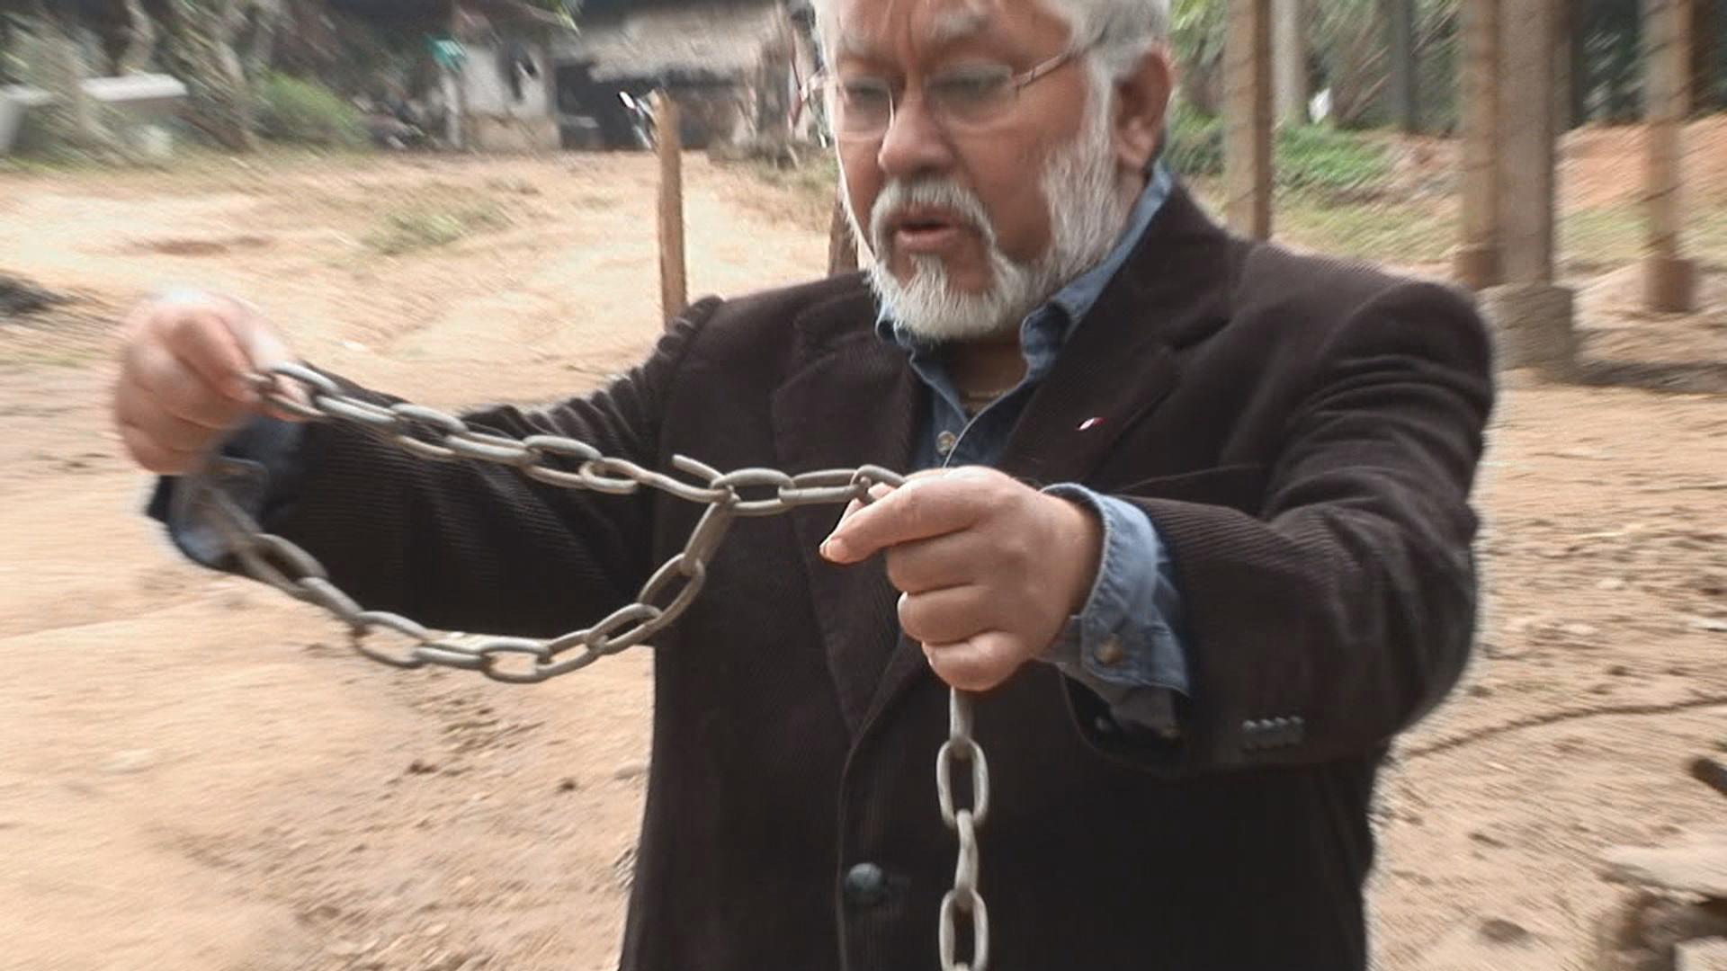

Slide 45
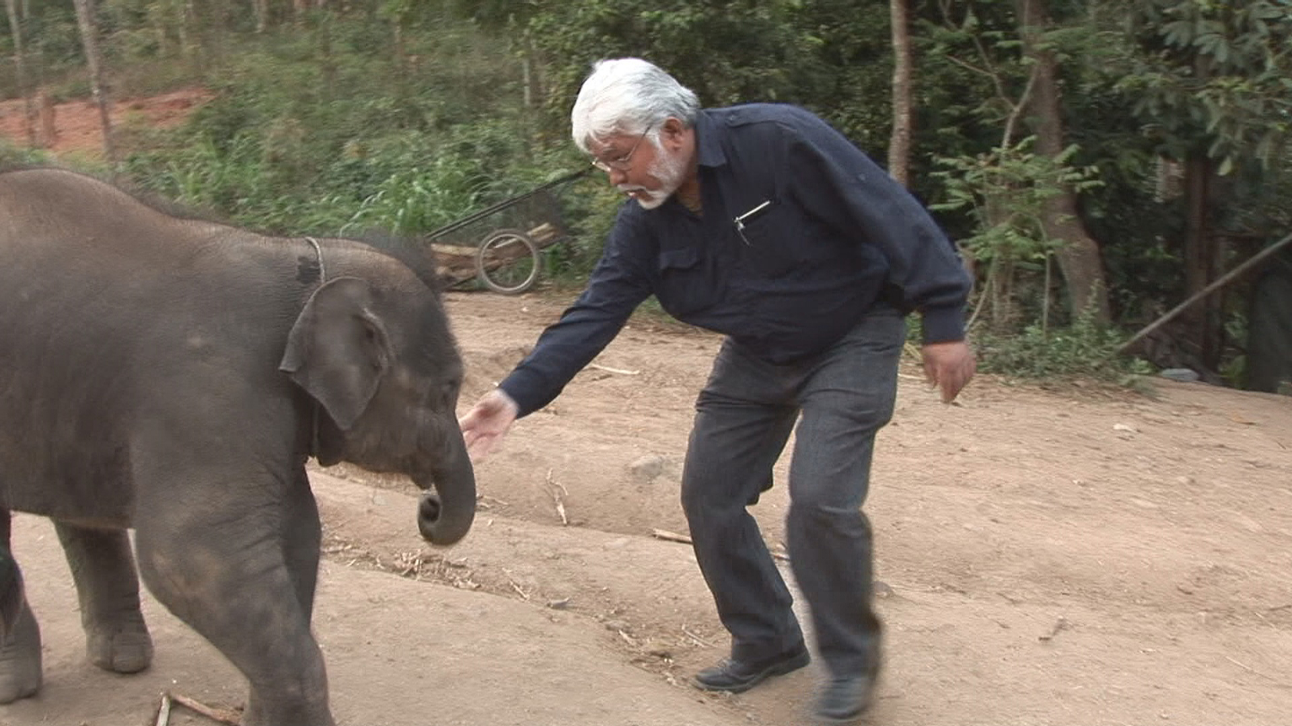

Slide 46
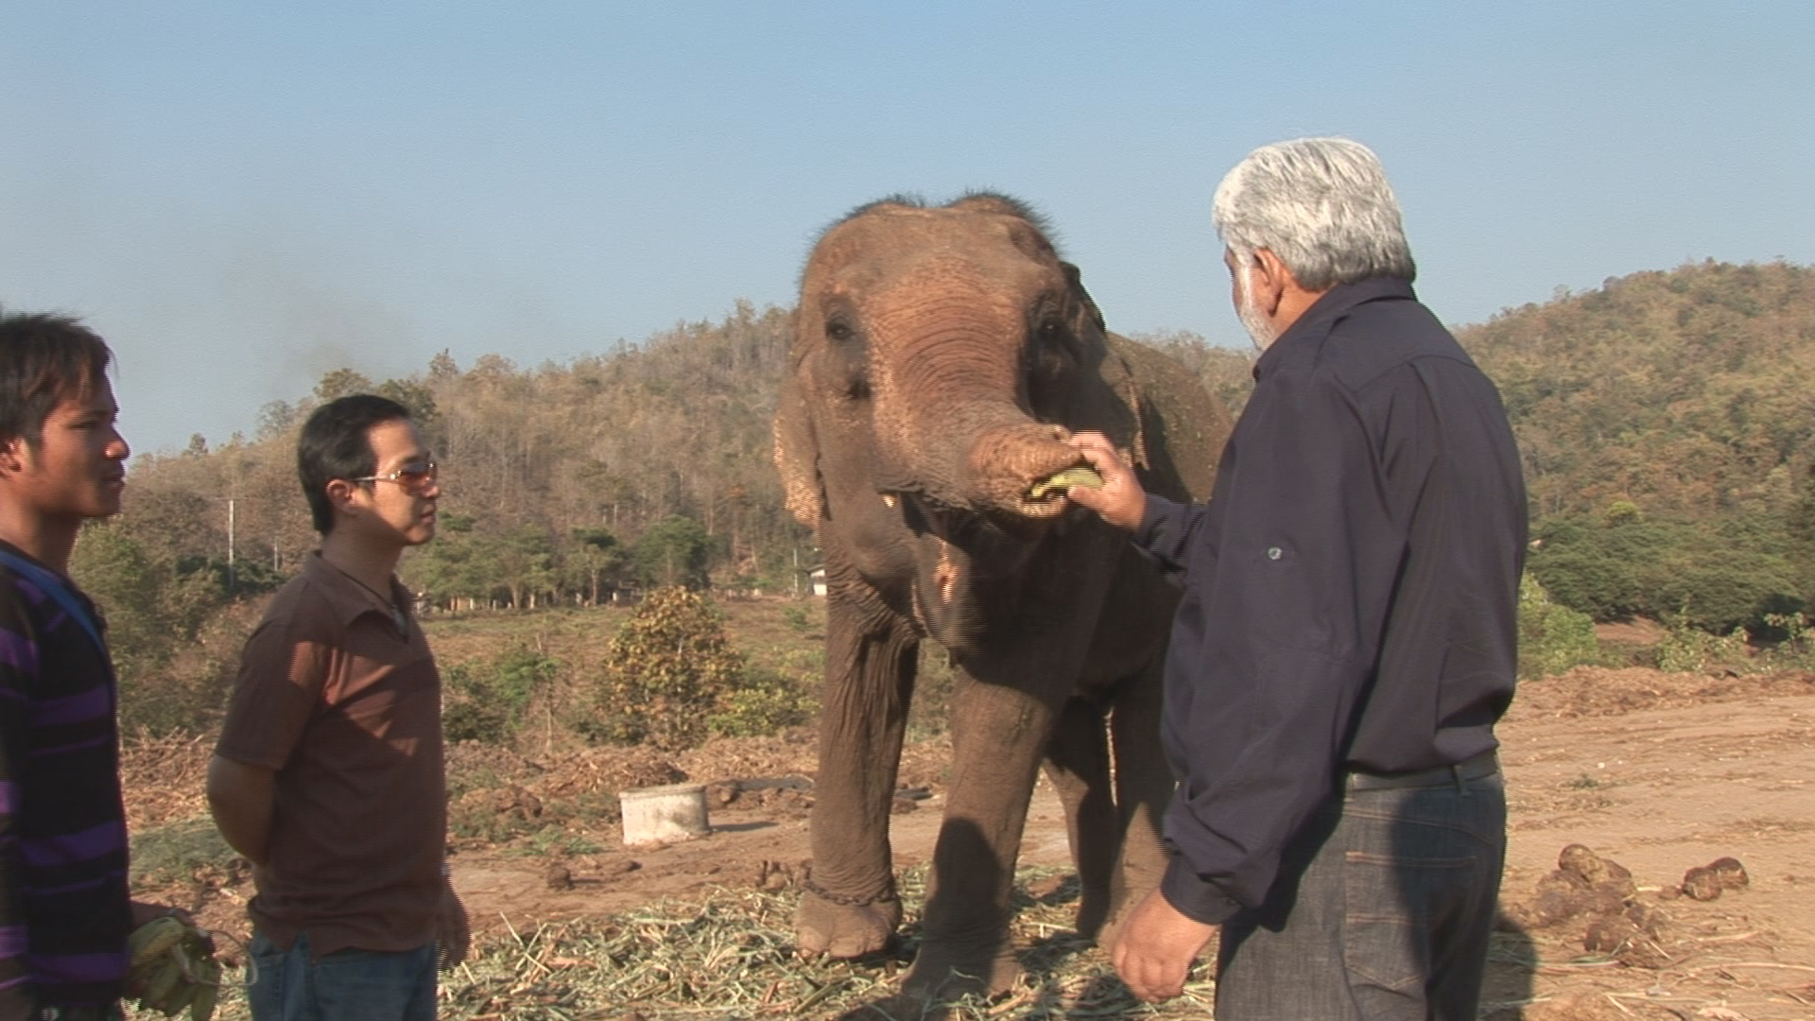

Slide 47
We see the chain as bondage and the elephants sees it differently. He sees it as his security.

Slide 48
When we don't feel the pain of our limitations, we don’t change
It becomes our comfort zone…regardless of how uncomfortable it is

Slide 49
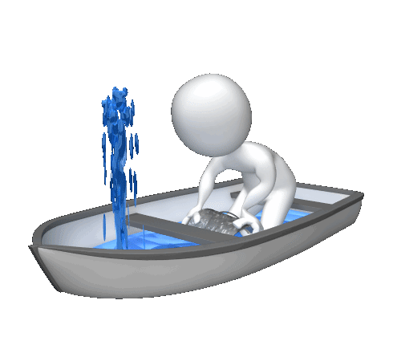

Slide 50
The elephant whose one foot is tied to a chain will not break the chain because he doesn't understand freedom.
The chain itself has become its freedom.
The occasional break of the chain for playing is like a vacation and then it wants to get back its chain.

Slide 51

Awakening to the Nishiiyuu Way and forming a new self image – breaking the chain

Slide 52
Homework
Create one single aim and set one goal

